Slide 1

Case Management Lab 2:
Engage and Motivate
Case Management Pre-Service Lab 2.0.1
Notes:
1.1.1

Slide 2


Agenda
Unit 2.1: Interviewing During Exploration
Unit 2.2: Interviewing to Engage and Motivate
Case Management Pre-Service Lab 2.0.2

Slide 3
Unit 2.1
Interviewing During Exploration
Case Management Pre-Service Lab 2.1.1
Notes:
5.1.4

Slide 4

Learning Objectives
Identify and demonstrate how to use motivational interviewing techniques to develop discrepancies, create decisional balance, and obtain mutuality.
Describe how to evoke change talk to elicit self-motivational statements.
Define self-efficacy and identify how to increase self-efficacy in parents.
Case Management Pre-Service Lab 2.1.2

Slide 5
Goals of Exploration Phase
Purposeful interaction with family to:
Continue to build productive working relationship
Gather descriptive details about child needs, caregiver protective capacities, stage of change
Evoke Change Talk
Raise self-awareness of family
Develop family change strategies
Case Management Pre-Service Lab 2.1.3

Slide 6
Developing Discrepancy
Current Behaviors &/0r Conditions
Which are counter to what I want for my child
Leads to motivation to change
Case Management Pre-Service Lab 2.1.4

Slide 7

Decisional Balance – Weighing the “Pros and Cons”
Case Management Pre-Service Lab 2.1.5

Slide 8
Exploring Potential Areas of Change with a Family
Sample Decisional Balance Sheet - Insert what Parent/Other Family Member “may” want to change
Continuing on as Before Making a Change
What are some of the good things… Benefits | What are some of the not so good things… Costs | What are some of the not so good things… Costs | What are some of the good things about change… Benefits
Case Management Pre-Service Lab 2.1.6

Slide 9

Observation: Developing Discrepancy and Decisional Balance
Case Management Pre-Service Lab 2.1.7
Notes:
https://www.youtube.com/watch?v=67tDoIuGdno
Video is 6 minutes long

Slide 10
Mutuality and Self-Determination
Mutuality:
“’Empathic bridge’ (Jordan, 1992) on which people from different perspectives can meet and engage in the dialogue necessary to create change without employing power-over tactics or inducing feelings of shame or humiliation. It requires practice of ‘radical respect’ (Walker 2004) which presumes that all human beings deserve freedom from contempt and deserve to be treated with dignity.” (Harling & Miller, 2004)
Self-Determination:
Right to select choices, make decision, chart their own course;
Affected by realities of circumstance;
Influenced by individual and social relationships;
Regulated by anticipated and real consequences;
Case Management Pre-Service Lab 2.1.8
Notes:
http://www.humiliationstudies.org/documents/hartling/HartlingExcerptMutuality.pdf

Slide 11
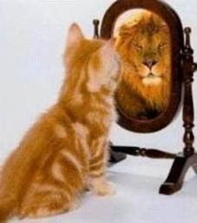
Self-Efficacy
https://www.youtube.com/watch?v=wrzzbaomLmc
https://www.youtube.com/watch?v=BWo7F5zcObM
Case Management Pre-Service Lab 2.1.9

Slide 12
Formula for Change
Awareness + Self-Efficacy = Change
Case Management Pre-Service Lab 2.1.10

Slide 13
Case Manager’s Tasks to Enhance Self-Efficacy
Believe in their ability to change.
Come to the realization they need to change.
Figure out what services or other steps and interventions will help them achieve change.
Assess the progress they are making, what is working well to help them make progress, what is not working well.
Adjust case plans as needed to help parent achieve success in achieving change.
Case Management Pre-Service Lab 2.1.11

Slide 14
Increasing Self-Efficacy
Case Manager’s engagement skills – remain open minded.
Vicarious experiences
Social persuasion
Control of emotive states
Case Management Pre-Service Lab 2.1.12

Slide 15


Activity A: Traps to Avoid
Instructions:
Instructor guided role-plays.
Pre-Service CM Specialty Module 2.1.13

Slide 16

Pre-Service CM Specialty Module 2.1.14

Slide 17
Change Prognosis
Case Manager tells why change is important and parent nods head.
Parent thinks about why change is personally important.
Parent talks about why change is personally important.
Parent makes verbal commitment to change.
LOW Probability of Behavior Change HIGH
Case Management Pre-Service Lab 2.1.15

Slide 18
Evoking Change Talk
Problem recognition
Family concern about problem
Family intention to change
Level of family optimism (self-efficacy)
Making decisions
Case Management Pre-Service Lab 2.1.16

Slide 19

Sample Questions: Eliciting Self-Motivational Statement
Case Management Pre-Service Lab 2.1.17

Slide 20
Activity B: Parent Self-Motivational Statement
Instructions:
Working in pairs, read each “Self-Motivational” statement and select if it describes: problem recognition, concern, determination, or optimism for change.
Be prepared to discuss your response.
Pre-Service CM Specialty Module 2.1.18

Slide 21
Unit 2.2
Interviewing to Engage and Motivate
Case Management Pre-Service Lab 2.2.1
Notes:
5.1.4

Slide 22
Learning Objectives
Identify the motivational interviewing technique, “Roll with Resistance.”
Identify and demonstrate interview techniques that diffuse resistance.
Case Management Pre-Service Lab 2.2.2

Slide 23
Use of Engagement Skills to Motivate
Case Management Pre-Service Lab 2.2.3

Slide 24
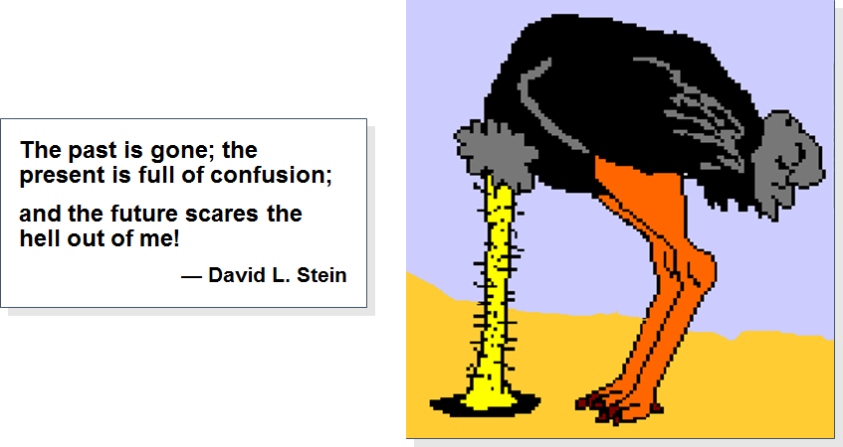
Roll with Resistance
The past is gone; the present is full of confusion; and the future scares the hell out of me!
David L. Stein
Case Management Pre-Service Lab 2.2.4

Slide 25

What does resistance look like?
Argument
Interruption
Denial
Ignoring
Case Management Pre-Service Lab 2.2.5

Slide 26

What is beneath resistance?
Person is feeling out-of-control
Person is feeling vulnerable (fear, anxiety)
Case Management Pre-Service Lab 2.2.6

Slide 27
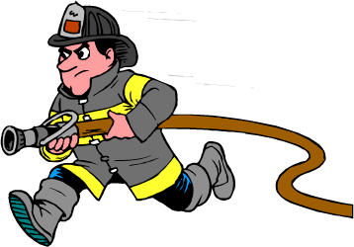
Strategies to Defuse Resistance
Simple reflection
Amplified reflection
Double-sided reflection
Shifting focus
Agreement with a twist
Emphasizing personal choice
Reframing
Case Management Pre-Service Lab 2.2.7

Slide 28
Simple Reflection
Definition:
Meet resistance by offering a simple acknowledgment of the person’s disagreement, feeling or perception.
Example:
Parent: “I am not the one with the problem. If I drink, its just because my husband is always nagging me.” (denying-blaming)
Case Manager: “You drink to help you deal with all the negative comments from your husband.”
Case Management Pre-Service Lab 2.2.8

Slide 29
Amplified Reflection
Definition:
Reflect back what the participant said in an amplified or exaggerated form to encourage the parent to elicit the other side, ambivalence.
Example:
Parent: “I can take care of my family myself. I don’t need social workers always checking up on me.”
Case Manager: “So you think you might be better off, really, without any help from anyone.”
Case Management Pre-Service Lab 2.2.9

Slide 30
A Double-Sided Reflection
Definition:
Acknowledging what the parent has said and adding the other side of his/her own ambivalence.
Example:
Parent: The parent has told you about the fun she has when drinking with friends, and also has told you about how awful she feels when she comes home and finds the kids fighting and hurt.
Case Manager: “You really like the good times you have with your friends when you are all drinking, and you are also concerned about how your kids are doing while you’re gone. Tell me more about that.”
Case Management Pre-Service Lab 2.2.10

Slide 31
Shifting Focus
Definition:
When a person appears stuck on an issue responding in a way that defuses the initial concern that the parent had and redirecting attention to an issue that is easier to address.
Example:
Parent: “I know that what you want is for me to be the perfect mom and never hit my kids, but I am not going to do that.” (Denying-unwillingness)
Case Manager: “I do not want us to get stuck on the use of corporal punishment. Right now, I am more interested in finding out what you like about being a parent in general.” (change the topic)
Case Management Pre-Service Lab 2.2.11

Slide 32
Agreement with a Twist
Definition:
Offer initial agreement, but with a slight twist.
Example:
Parent: “Why are you and my wife so stuck on my drinking? What about all her problems? (Denying-blaming, excusing)
Case Manager: “Drinking problems do tend to involve the whole family. I agree with you that we shouldn't be trying to place blame here. I think you’re absolutely correct, we should look at everybody’s piece of the puzzle.”
Case Management Pre-Service Lab 2.2.12

Slide 33
Emphasizing Personal Choice and Control
Definition:
Emphasizing personal choice and control when people think that their freedom of choice is being threatened, they may react by asserting their liberty.
Example:
Parent: "Nobody tells me what to do, nobody!"
Case Manager: Assure the parent that in the end, change really is dependent upon each individual’s commitment to it.
Case Management Pre-Service Lab 2.2.13

Slide 34
Reframing
Definition:
Reframing information that the parent is offering in a way that acknowledges the validity of the family’s raw observations, but offers a new meaning or interpretation for them.
Example:
Parent: “My kids are gonna have respect for authority. They quit their fighting when I threaten them because they know I’ll back it up . . . so it works. ”
Case Manager: “It’s important to you that you’re children respect authority. How have you explained our relationship to them?
Case Management Pre-Service Lab 2.2.14

Slide 35
Activity C: Defusing Resistance
Instructions:
In small groups, take turns role playing the roles of the Case Manager, Melanie and the Observer.
Use different strategies to address Melanie’s sense of vulnerability and Mr. Braun’s fear of loss of control.
Pre-Service CM Specialty Module 2.2.15

Slide 36
Unit 2.3
Follow-up Field Activity
Notes:
5.1.4

Slide 37
Learning Objectives
While in the field, participants will observe an interview and recognize interviewing skills and techniques learned and practiced in Lab 2.
Case Management Pre-Service Lab 2.3.2

